Slide 1
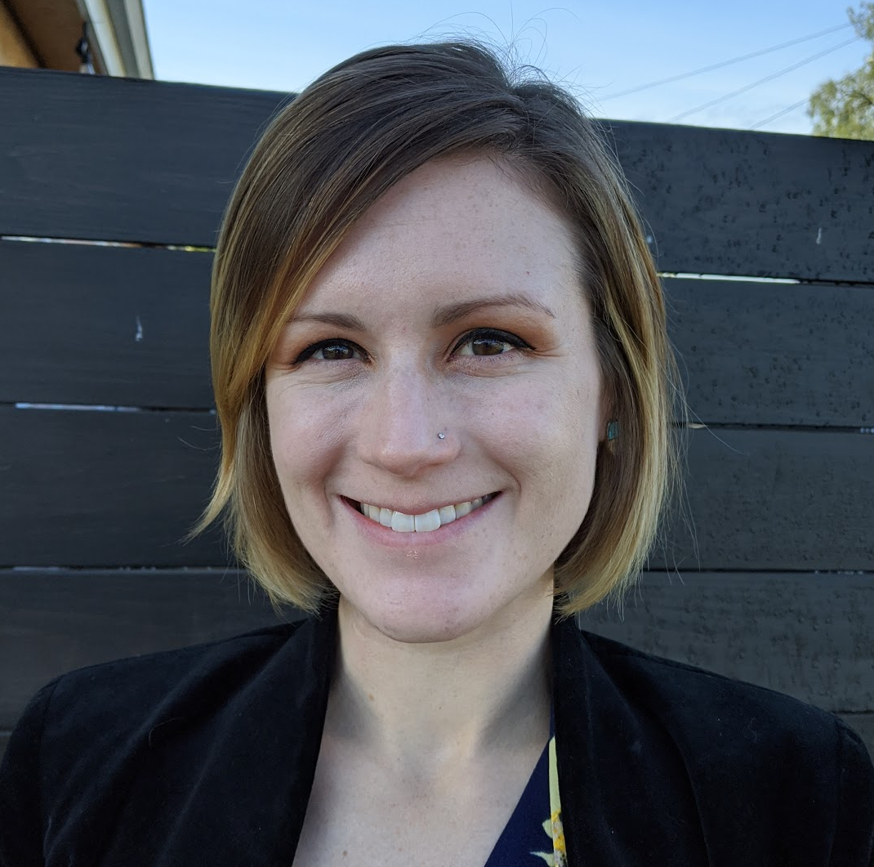
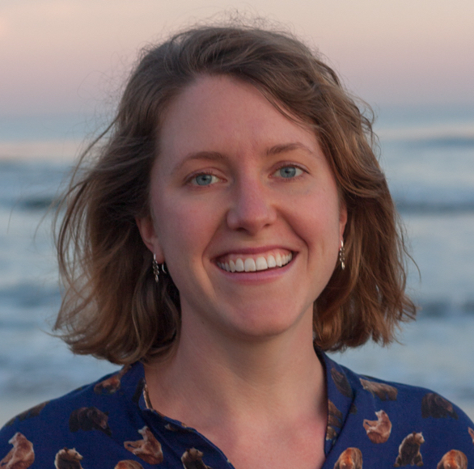
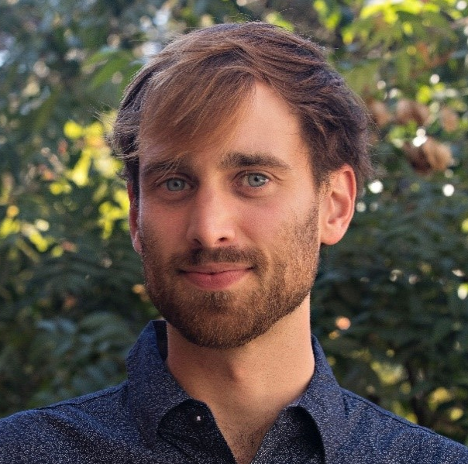
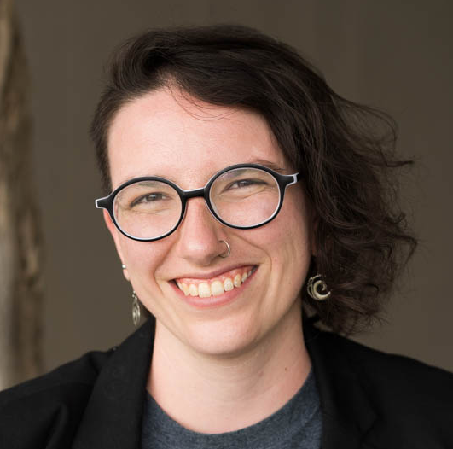


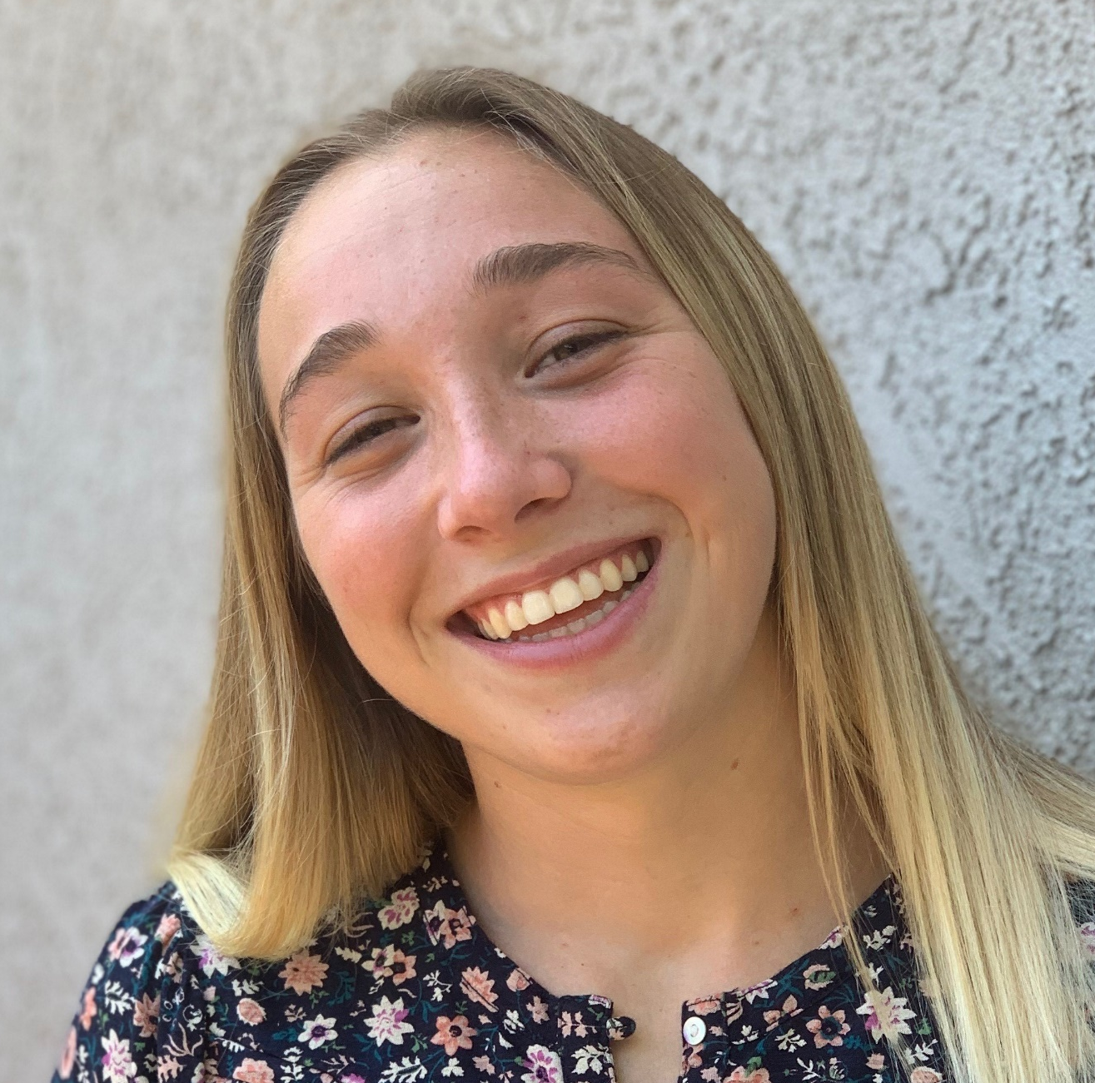
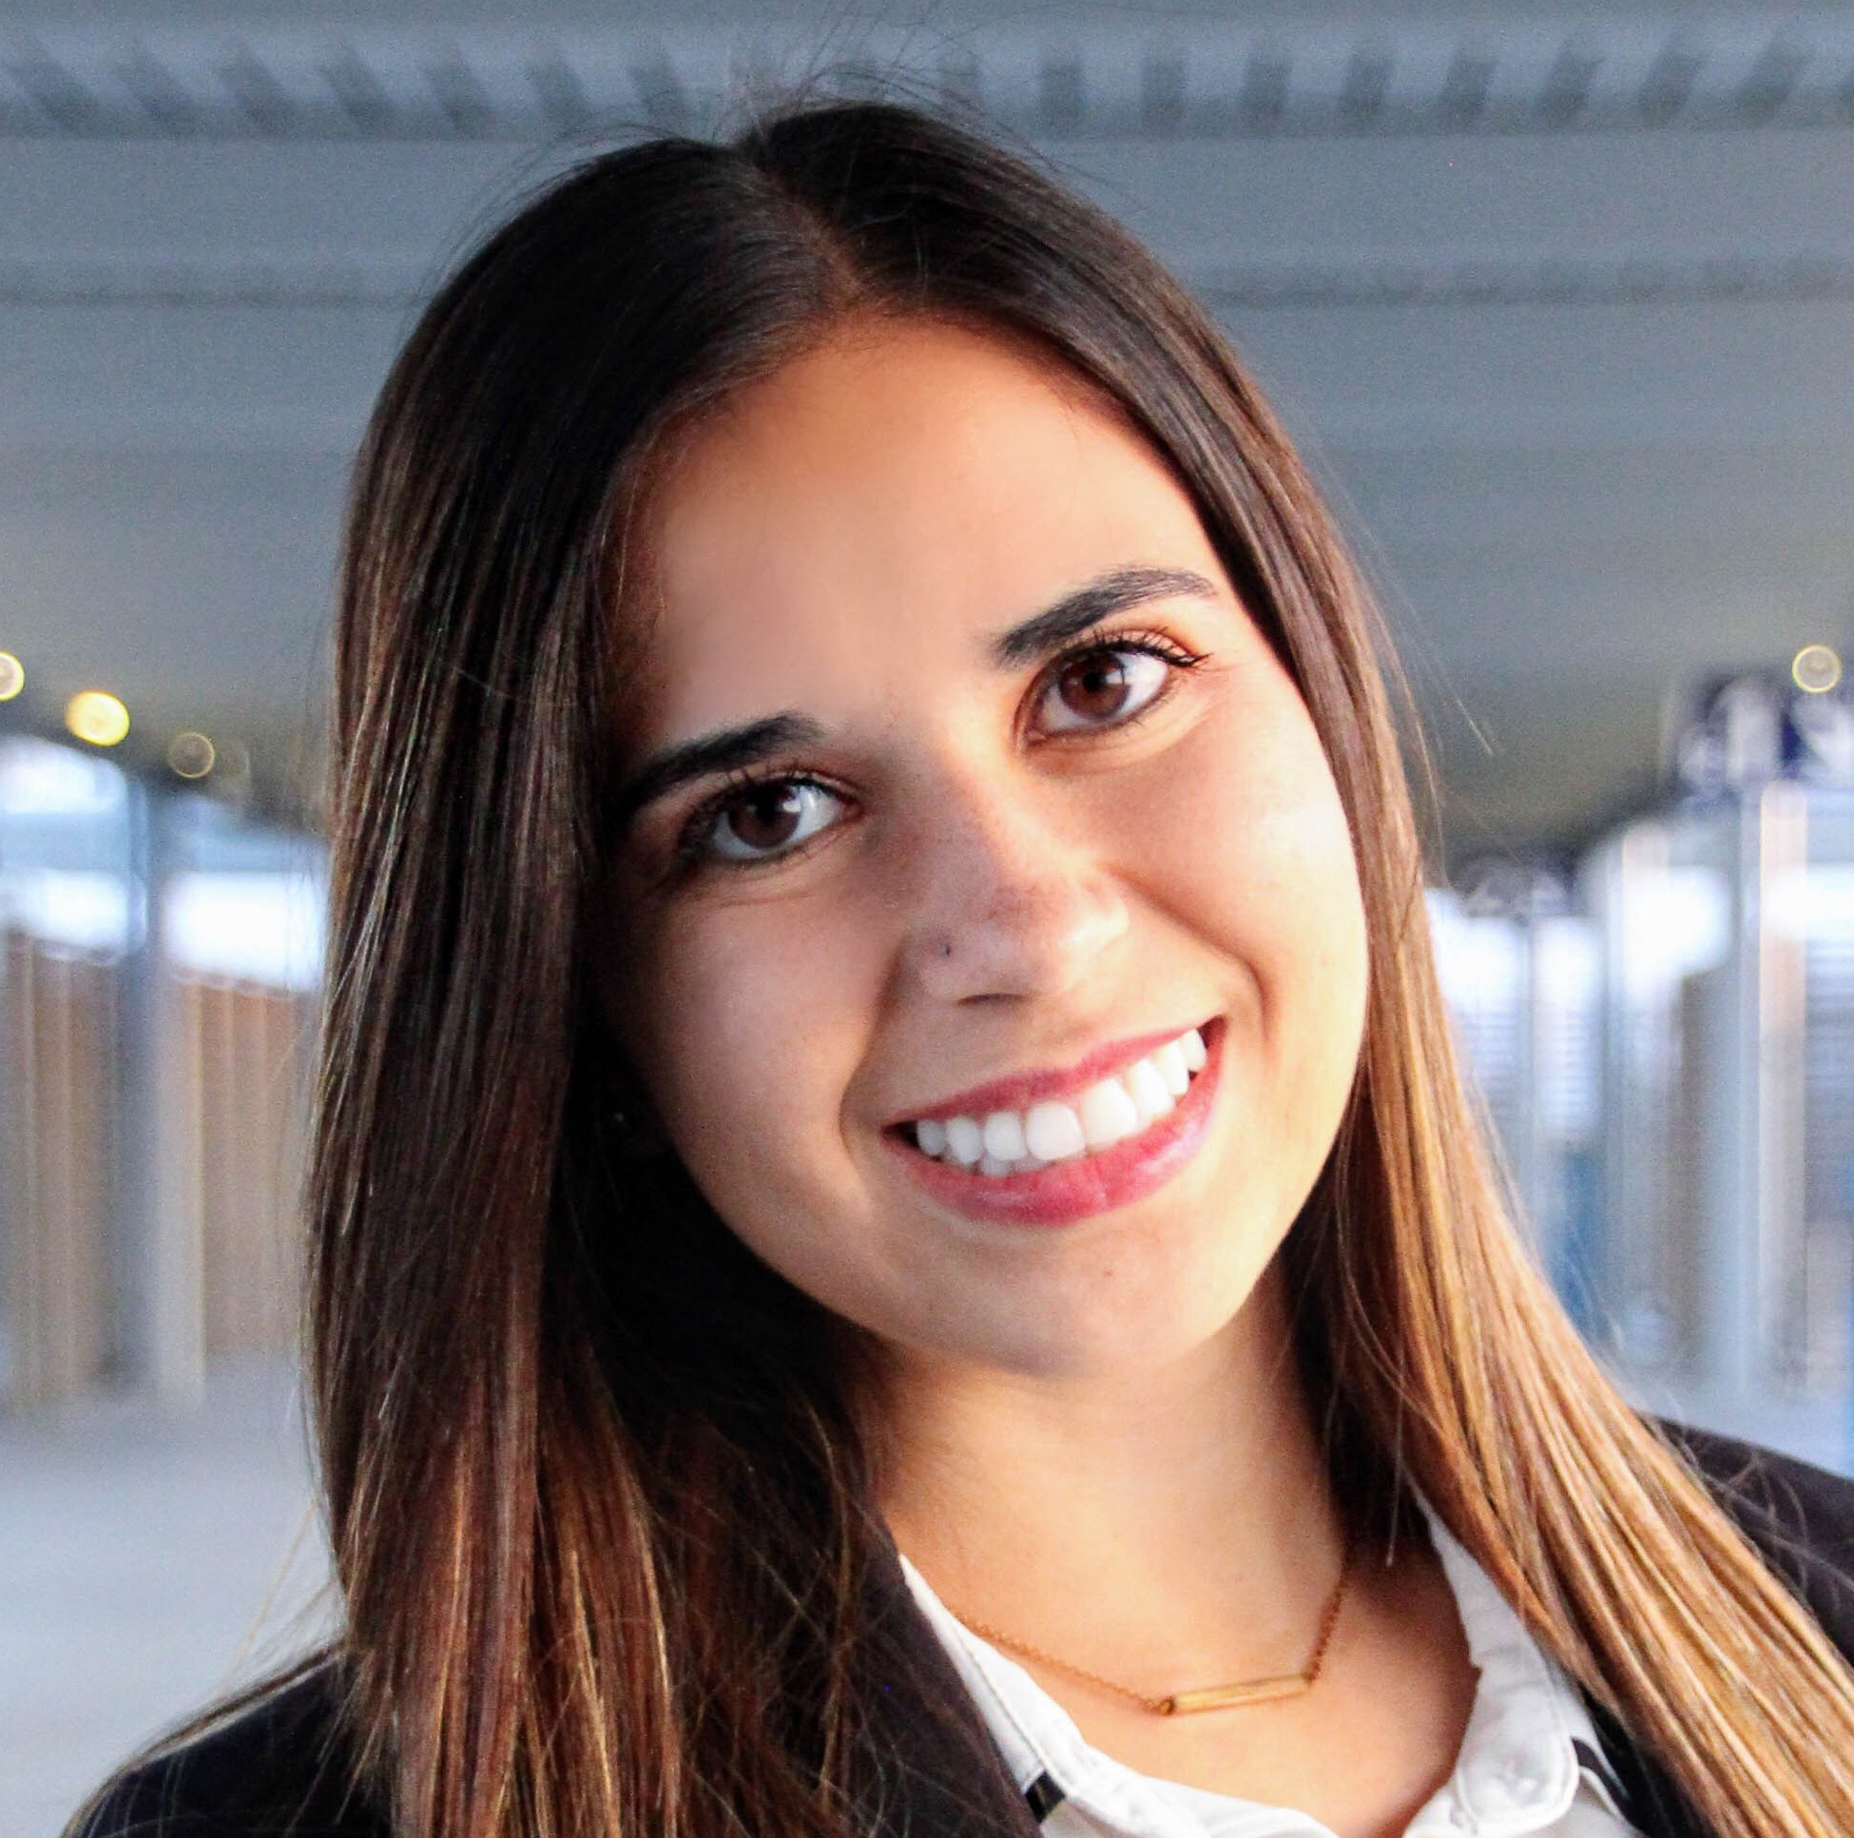
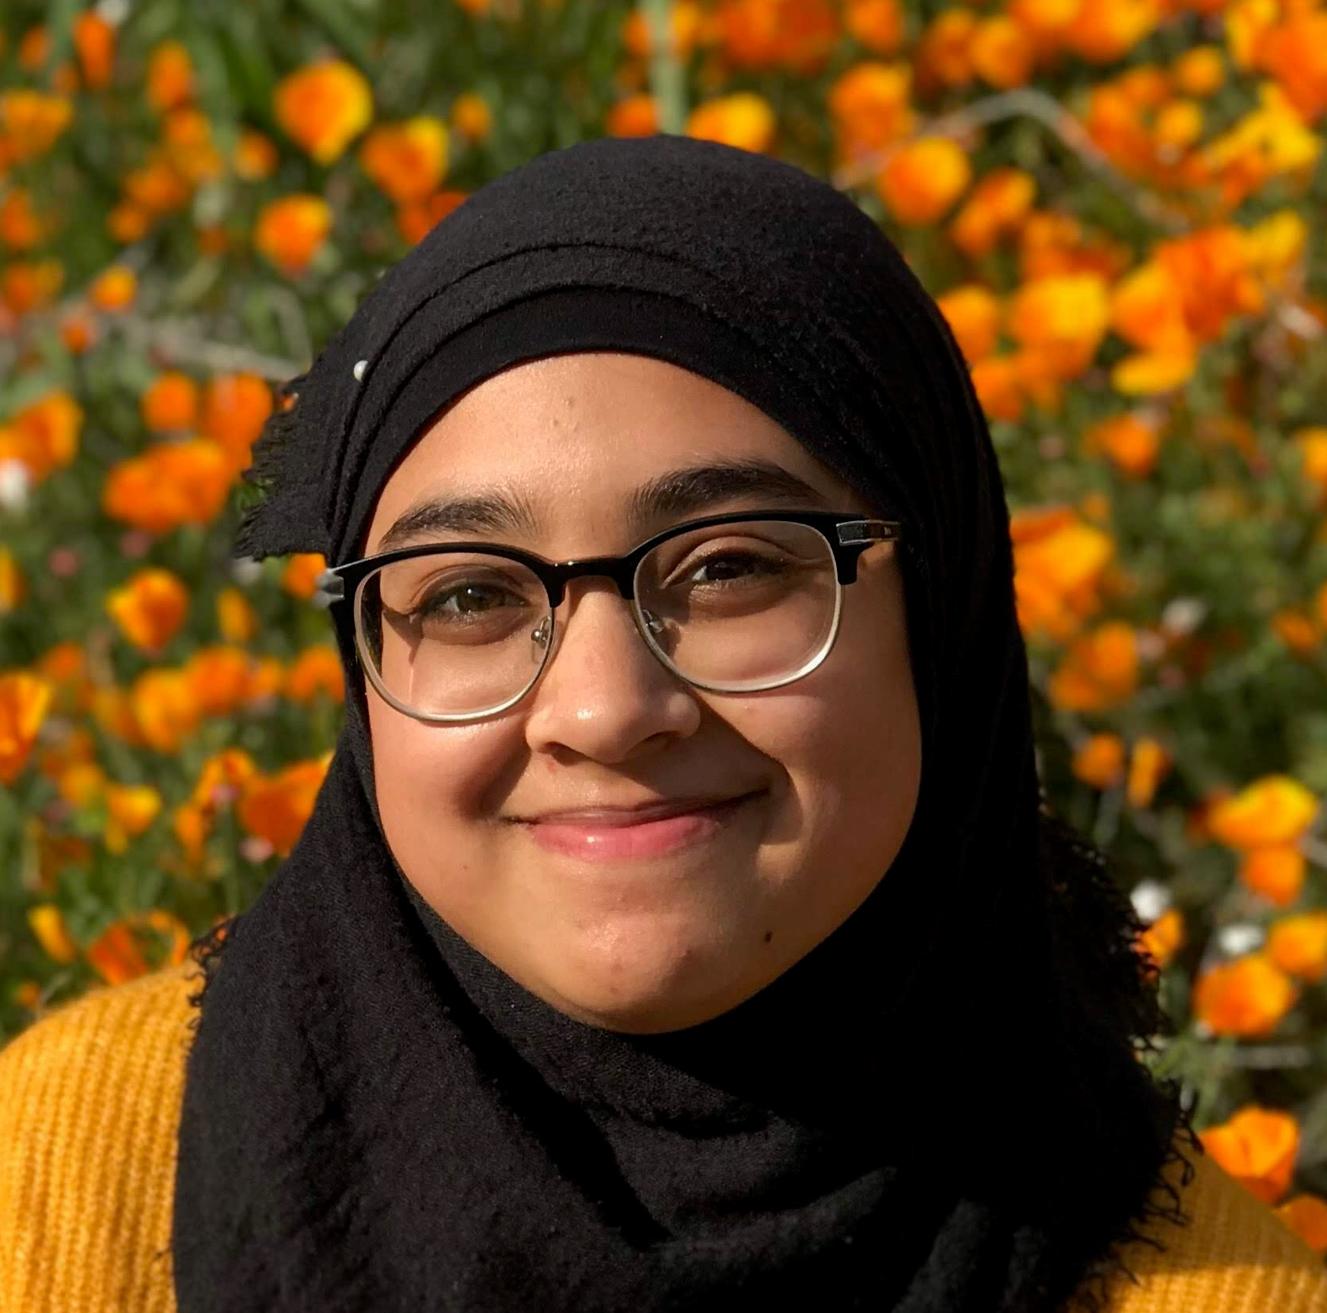
Dr. Leah Thornton Hampton
Southern California Coastal Water Research Project
Conceptualization, Data Curation & Visualization
Dr. Heili Lowman
Southern California Coastal Water Research Project
Data Visualization
Dr. Scott Coffin
California Water Resources Control Board
Conceptualization & Data Visualization
Dr. Ezra Miller
San Francisco Estuary Institute
Data Curation
@DrLeahTH
leahth
@heili_lowman
hlowman
@DrScottCoffin
ScottCoffin
Emily Darin
Southern California Coastal Water Research Project
Data Visualization
Syd Kotar
Southern California Coastal Water Research Project
Data Curation
Sarah Khan
Southern California Coastal Water Research Project
Data Curation

Slide 2

